Slide 1

ATC
Advanced Technologies Committee
(2023-2024)
Overview ATC activities (Bert van Duijn)
Consortium for sharing image data for the development of Imaging Technologies for seed quality testing (Ganesh Kumar, Craig McGill, Bert van Duijn)
Notes:
Presentation title slide

Slide 2

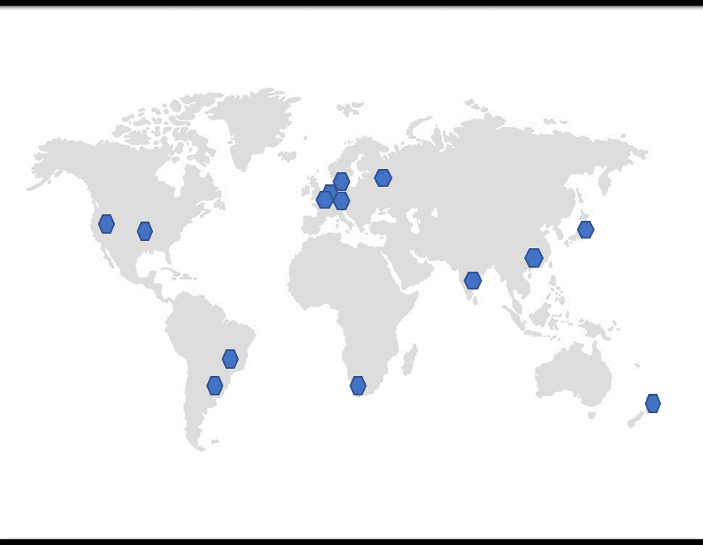
16 Members from 13 Countries
Bert van Duijn (NL), chair
Francisco G. Gomes Junior (BR), vice chair
Brigitte Hamman (SA)
Devaraja Achar A.M. (IN)
Birte Boelt (DK)
Sebastian Bopper (GER)
Kent J. Bradford (USA)
Henry Bruggink (NL)
Aurélie Charrier (FR)
Giovanny Lopez (NL)
Mailén Ariela Martinez (AR)
Nikolay S. Priyatkin (RU)
Tomoko Sakata (JP)
Zhujun Zhu (CN)
Sunmeet Bhatia (NZ)
Ganesh Kumar (USA)
Ecom liason: Craig McGill
Text
Text
Notes:
Presentation title slide

Slide 3
Current working groups
  X-ray based technologies
    2D X-ray
    3D X-ray
  (Multi spectral) Imaging
  (Mathematical) Modelling in seed testing (with STA & MOI)
  Molecular Technologies
  Exploring central depository for images of Physical Purity (with STA, Ecom members)
  Practical guidelines for image analysis (with PUR, STA, GER, VIG)
  Workshops/ seminars
Notes:
Presentation title slide

Slide 4
ATC involvement in 2 ISTA funded special projects
Assessment on available technologies of imaging and image analysis for other seeds determination (OSD), purity analysis and germination.
(Collaboration between PUR, ATC and GER), Finalized 2023
Exploration of methods for detecting insects in seed lots.
(Collaboration between SHC and ATC), Finalized 2023
Notes:
Presentation title slide

Slide 5
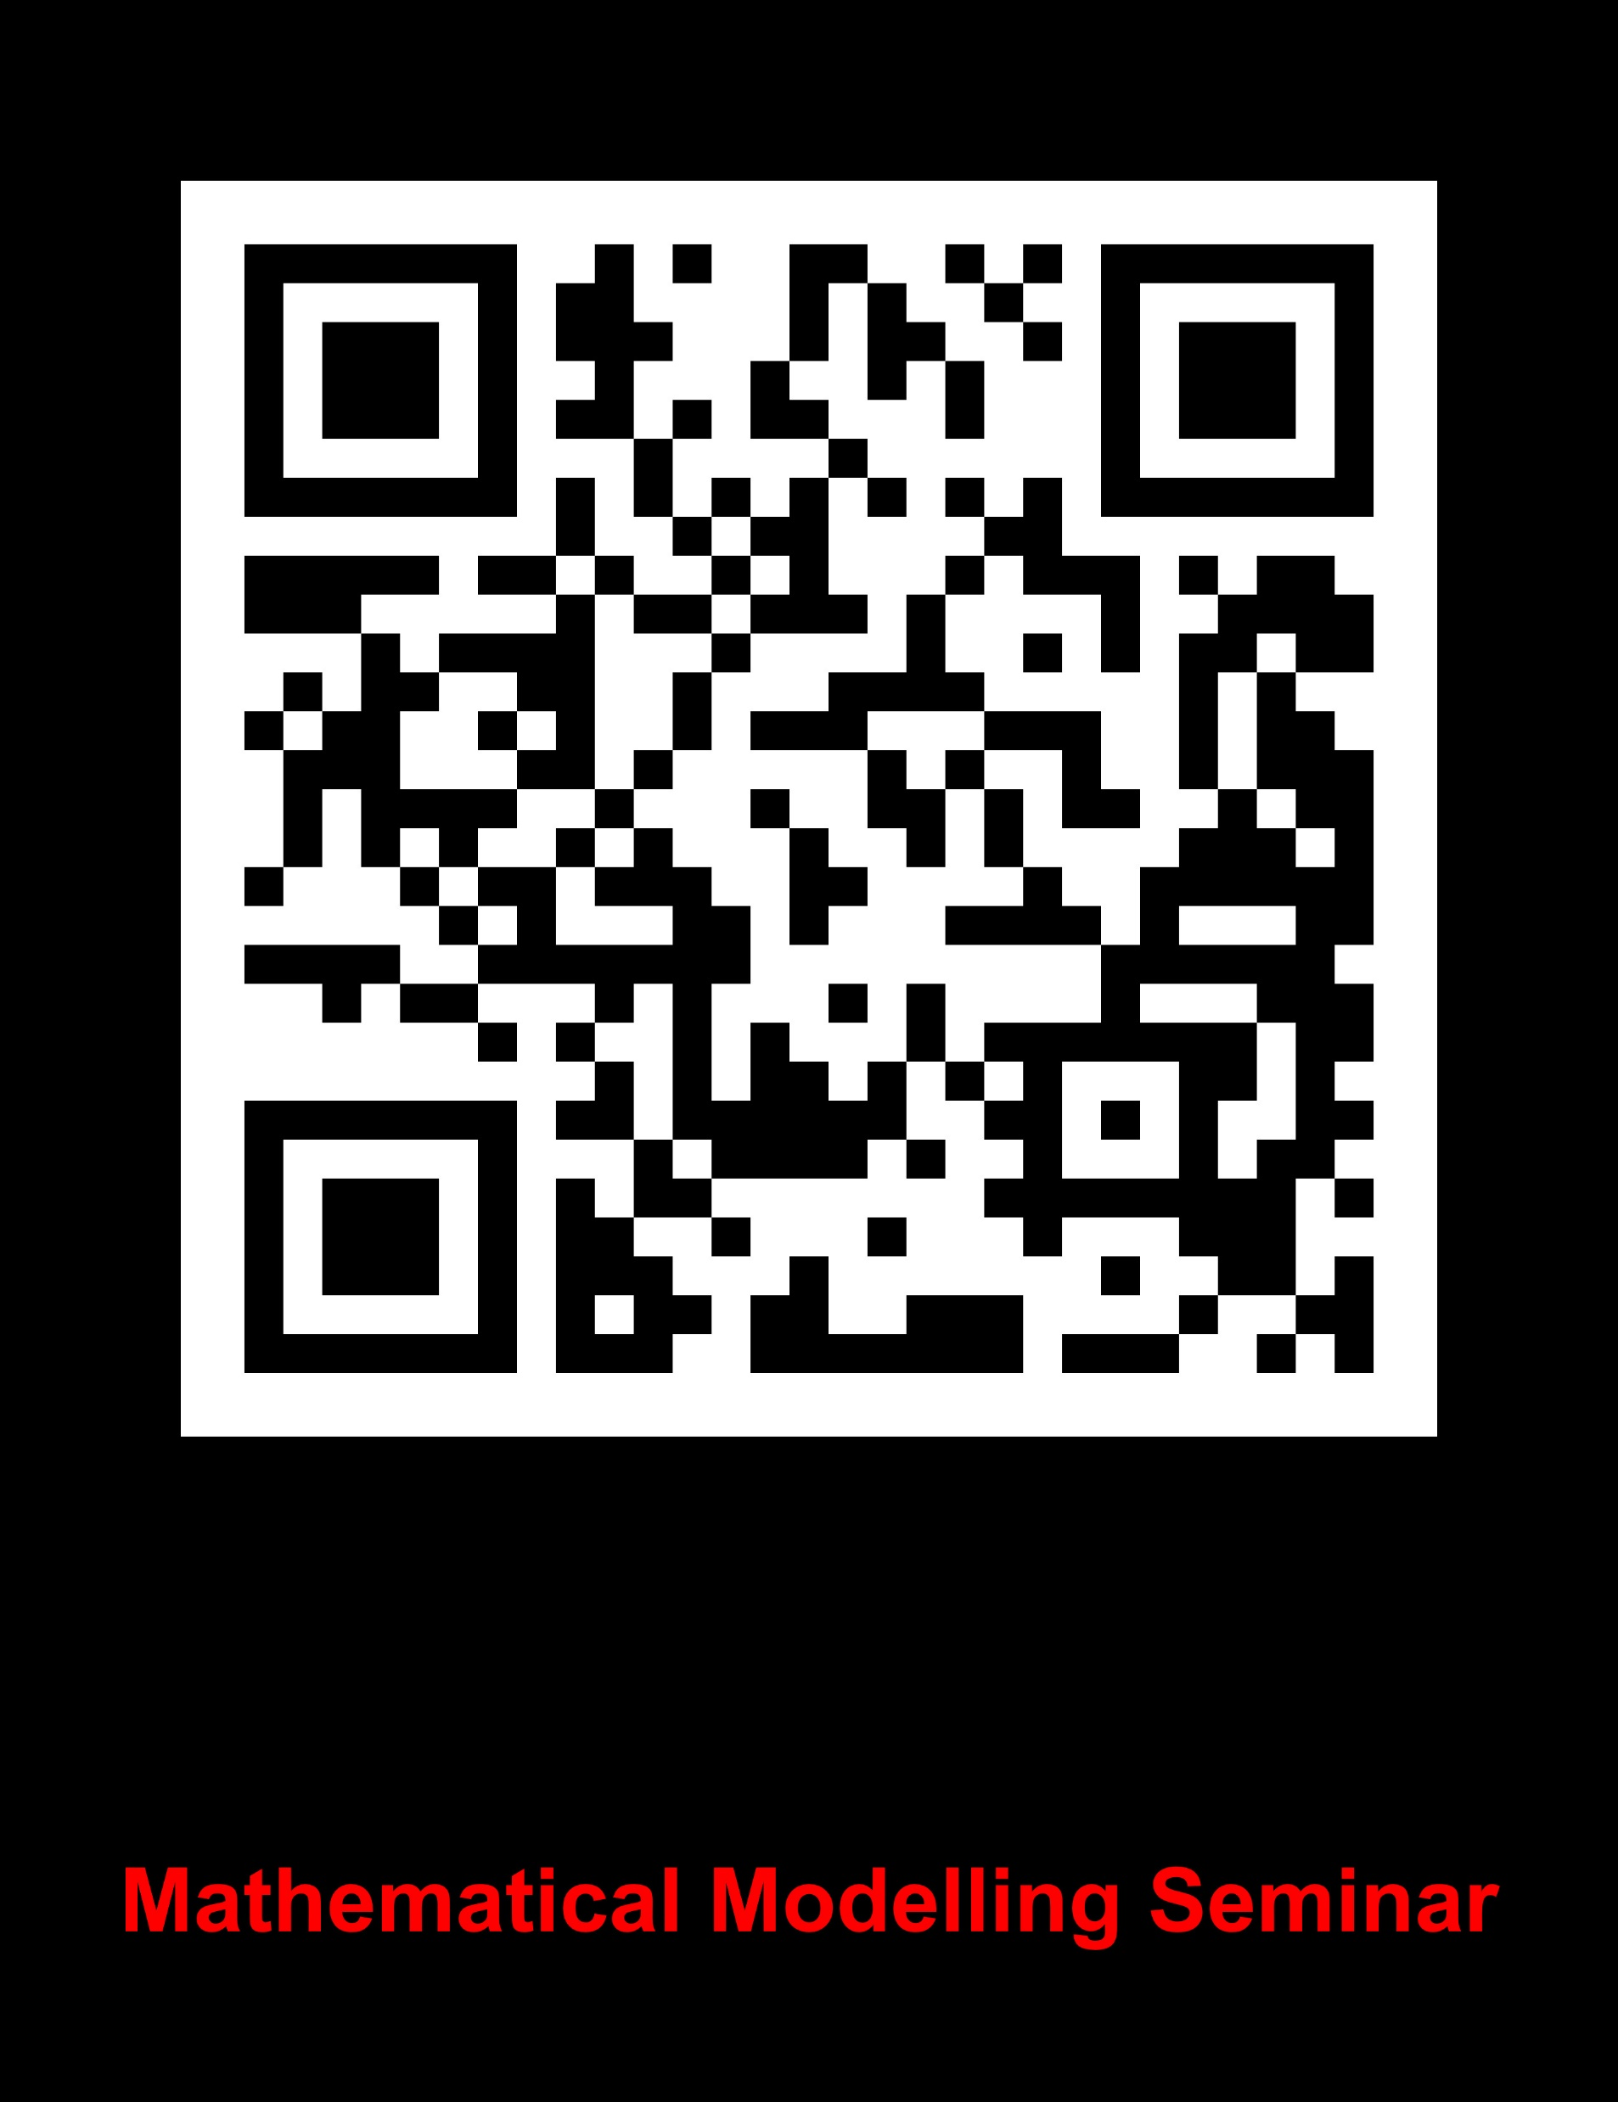
Seminar/interest meeting on Mathematical modelling in seed testing (May 31, 2023, Verona)
Introduction to the initiative and types of modelling to consider
Bert van Duijn, ATC / Tomoko Sakata, ATC
The Ellis-Roberts viability equations to model seed longevity in storage and extension into germination time courses via the PBT models
Fiona Hay, MOI / Kent Bradford, ATC
A.I. Based Modelling in Seed Imaging Applications
  Kyle T. Peterson (Bayer Crop Sciences, Innovation Science & Engineering, USA)
Discussion on Assessing Uncertainty in Seed Testing Models & Statistics Committee Activities
Jean-Louis Laffont, STA / Kirk Remund, STA
Wrap up and discussion.
Notes:
Presentation title slide

Slide 6
Lectures (selection)
ISTA Annual Meeting 2023, Verona
  Report lecture/discussion: Insect detection in seed (Aurélie Charrier, ATC)
Joint FAO/ISTA Webinar: New Technologies in Seed Testing October 4, 2023
  Emerging trends and future outlook of modern technologies in seed quality testing (Bert van Duijn, ATC)
  Seed moisture testing (Kent Bradford. ATC)
  Adoption of modern seed testing technologies across the world and how to address the capacity needs and gaps in different countries. (Aurélie Charrier, ATC)
DanSeed Symposium 2023, Kobæk Strand Konferencecenter, Denmark. March 6-7 2023.
  ISTA technical projects – purity by number and insects. (Birte Boelt, ATC)
The fifth international conference with tutorial day "Physics for Life Sciences“ November, 2023
  Electrophotography is a promising method for seed quality assessment. (Nikolay Priyatkin, ATC)
ISSS-ISTA webinar for ‘Seed priming’ November 29, 2023
  Seed priming: practical commercial use and its evaluation. (Tomoko Sakata, ATC)
Notes:
Presentation title slide

Slide 7
Publications (selection 2023)
Advanced Technologies Committee (report) | Bert van Duijn (Chair) and Francisco G. Gomes Jr (Vice-Chair) | Seed Testing International No. 166, October 2023 pp. 34-35
ISTA’s First Scientific Writing Workshop 1 November 2022, Athens. | Sunmeet Bathia, Kalomoira Delga, Sebastian Bopper and Marie-Hélène Wagner (ATC and VIG) | Seed Testing International No. 165, April 2023 pp. 51.
Concluding paper on Exploration of Methods for Detecting Insects in Seed Lots. | SHC, ISTA Special project 20-1: Exploration of Methods for Detecting Insects in Seed Lots. | Seed Testing International
Summary and Recommendations from ISTA Special Project 19-1: Application of Marketplace Available Technologies of Computer Vision in Seed Testing | Ruojing Wang, Liang Zhao, Bert van Duijn (PUR and ATC) | Seed Testing International No. 165, April 2023 pp. 21-24.
Chapter X-ray imaging in “Handbook of Tree and Shrub seed testing” | Tree and Shrub Seed Committee
Valorization of sorghum ash with digestate and biopreparations in the development biomass of plants in a closed production system of energy | Z. Romanowska-Duda, Regina Janas, Mieczyslaw Grzesik (ATC) Bert van Duijn (ATC) | October 2023 Scientific Reports 13(1) DOI: 10.1038/s41598-023-45733-9
A chemometric method for the viability analysis of spinach seeds by near infrared spectroscopy with variable selection using successive projections algorithm | Madan Kumar Lakshmanan, Birte Boelt (ATC) and Rene Gislum | Journal of Near Infrared Spectroscopy 2023, Vol. 31(1) 24–32. DOI: 10.1177/09670335221138955
Application of gas discharge visualisation technique for seeds hidden defects evaluation. | PRIYATKIN N.S. (ATC) et al. | Theoretical and Applied Ecology. - 2023. No.3. - P. 37–48. DOI: 10.25750/1995-4301-2023-3-037-04
Evaluation of heterogeneity and hidden defects of wheat (Triticum aestivum L.) seeds by instrumental physical methods. | PRIYATKIN N.S (ATC) et al. | Sel'skokhozyaistvennaya Biologiya [Agricultural Biology], 2022, Vol. 57, № 5, p. 911-920. doi: 10.15389/agrobiology.2022.5.911eng
X-ray and Micro-CT image analysis of soybean seeds in relation to the Tetrazolium Test. | Martinez, M.A. (ATC); Arango Perearnau, M.R.; Andretich, G.; Peralta, M.; Airaldo, G.; Gallo, C. | ISTA Seed Symposium Athens, Greece.
Chlorophyll retention and low oxygen consumption rates in soybean seeds produced under heat-drought stress. | Martinez, M.A (ATC)Montechiarini, N.H.; Gosparini, C.O.; Oppedijk, B.; van Duijn, B. (ATC) | XXXIV Argentinian Meeting of Plant Physiology (RAFV 2023), Rosario, Argentina.
The influence of seed moisture content on the results of the Radicle Emergence test of rapeseed (Brassica napus) | Bopper, S. (ATC)), Goertz, S, Zur, J. and M. Kruse | Seeds” 134th VDLUFA Congress. Page https://www.vdlufa.de/wp-content/uploads/2023/08/Kurzfassungen.pdf
Notes:
Presentation title slide

Slide 8
Planned Workshops and Seminars
ATC lectures Annual Meeting in Cambridge: new technologies
Wednesday July 3. 16.16 – 17.15 Debating Chamber
ATC workshop - Imaging in seed quality assurance
Hyderabad: in planning
ATC-SHC workshop – Insect detection in seeds
March 23-25, 2025. Angers, France
ATC seminar – Advances in Seed Testing
April 2025. Hangzhou, China
Notes:
Presentation title slide

Slide 9
In the Annual Meeting 2024
ATC lectures Annual Meeting in Cambridge: new technologies
Wednesday July 3. 16.16 – 17.15 Debating Chamber
Exploring Molecular Tools for Evaluating Seed Quality
Giovanny Lopez (ATC)
Developments in Multispectral Imaging and Image Analysis on seeds
Birte Boult (ATC)
An example of using Bayesian statistics: revised OSD heterogeneity testing under certain conditions
Kirk Remund and Jean-Louis Laffont (STA)
Working group on practical guidelines for Image Analysis
Wednesday July 3. 14.45 – 15.45 Debating Chamber
Introduction, feed back and next steps (Ruojing Wang, PUR / Bert van Duijn, ATC)
Notes:
Presentation title slide

Slide 10

Thank you
Notes:
Presentation title slide

